Slide 1
“ WE DON’T SEE THINGS AS THEY ARE, WE SEE THINGS AS WE ARE.”

Slide 2
Perception
“ The study of perception is concerned with identifying the process
through which we interpret and organize sensory information to
produce our conscious experience of objects and object relationship.”
“ Perception is the process of receiving information about and making sense of the world around us. It involves deciding which information to notice, how to categorize this information and how to interpret it within the framework of existing knowledge.
“ A process by which individuals organize and interpret their sensory impressions in order to give meaning to their environment.
Organizational Behavior / Perception

Slide 3
The Perceptual Process
Sensation
  An individual’s ability to detect stimuli in the immediate environment.
Selection
  The process a person uses to eliminate some of the stimuli that have been sensed and to retain others for further processing.
Organization
  The process of placing selected perceptual stimuli into a framework for “storage.”
Translation
  The stage of the perceptual process at which stimuli are interpreted and given meaning.
Organizational Behavior / Perception

Slide 4
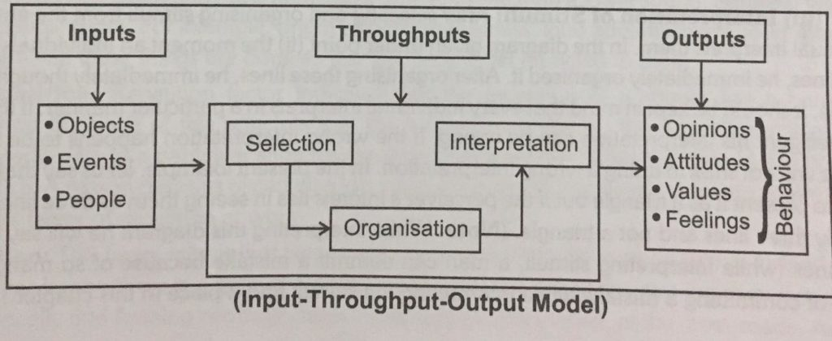
Organizational Behavior / Perception

Slide 5
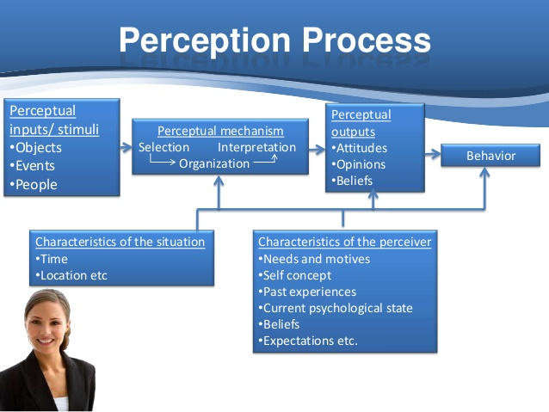
Organizational Behavior / Perception

Slide 6
Organizational Behavior / Perception

Slide 7
Factors influencing perception
A number of factors operate to shape and sometimes distort perception. These factors can reside in the perceiver, in the object or target being perceived or in the context of the situation in which the perception is made.
Organizational Behavior / Perception

Slide 8
Factors influencing Perception
Factors in the perceiver
Attitudes
Motives
Interests
Experience
Expectations
Factors in the situation
Time
Work Setting
Social Setting
Perception
Factors in the Target
Novelty
Motion
Sounds
Size
Background
Proximity
Similarity
Organizational Behavior / Perception

Slide 9
Perceptual organization
It is the process by which we group outside stimuli into recognizable and identifiable patterns and whole objects.
Certain factors are considered to be important contributors on assembling, organizing and categorizing information in the human brain. These are
Figure ground
Perceptual grouping
Organizational Behavior / Perception

Slide 10

Figure-Ground Illustration
Field-ground differentiation
  The tendency to distinguish
  and focus on a stimulus that
  is classified as figure as
  opposed to background.
Organizational Behavior / Perception

Slide 11
PERCEPTUAL GROUPING
Our tendency to group several individual stimuli into a meaningful and recognizable pattern.
It is very basic in nature and largely it seems to be inborn.
Some factors underlying grouping are
-continuity
-context
-proximity
-similarity
Organizational Behavior / Perception

Slide 12
Perception errors and Distortions
Organizational Behavior / Perception

Slide 13
Errors and Distortion
Selective Perception :
People selectively interpret what they see on the basis of their interests, background, experience and attitudes.
Halo Effect :
Drawing a general impressions about an individual on the basis of a single characteristics.
Stereotyping :
Judging someone on the basis of one’s perception of the group to which that persons belongs.
Organizational Behavior / Perception

Slide 14
4 Contrast Effect :
Evaluation of a person’s characteristics that are effected by comparisons with other people recently encountered who rank higher or lower on the same characteristics.
5. Projection :
Attributing one's own characteristics to other people.
6. Impression ( Recency Effect):
Forming impression on the basis of first impression.
7. Inference
Making judgments on the basis of very less information.
8. Performance expectation ( Self- Fulfilling Prophecy) or Pygmalion Effects:
Self-fulfilling prophecy, process through which an originally false expectation leads to its own confirmation. In a self-fulfilling prophecy an individual's expectations about another person or entity eventually result in the other person or entity acting in ways that confirm the expectations.
Organizational Behavior / Perception

Slide 15
Attribution
It means giving cause and effect explanation to the observed behavior.
Perceptual Sets
Organizational Behavior / Perception

Slide 16

Organizational Behavior / Perception

Slide 17

Organizational Behavior / Perception

Slide 18
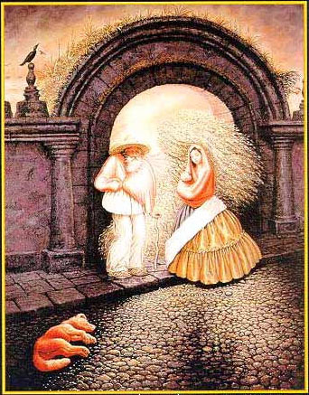
Organizational Behavior / Perception

Slide 19

Organizational Behavior / Perception

Slide 20
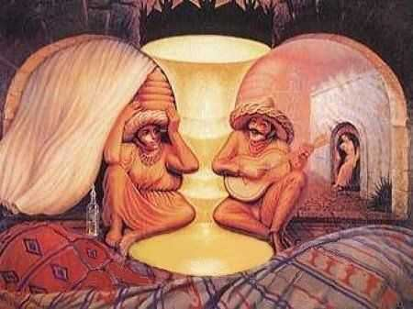
Organizational Behavior / Perception

Slide 21
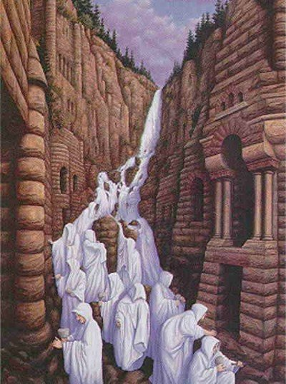
Organizational Behavior / Perception

Slide 22
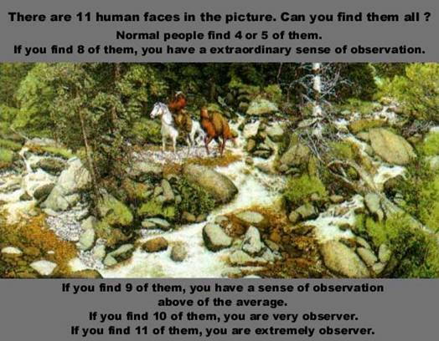
Organizational Behavior / Perception

Slide 23

Organizational Behavior / Perception

Slide 24

Organizational Behavior / Perception

Slide 25
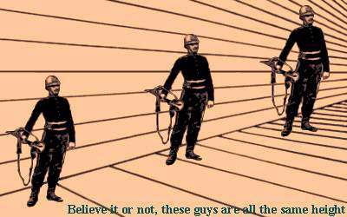
Organizational Behavior / Perception

Slide 26
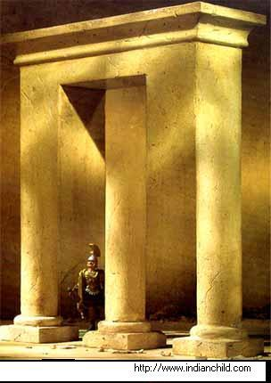
Organizational Behavior / Perception

